Slide 1
PROJECT1:
Cat and dog classification CNN model
Team1: DO QUANG HUY, 강덕현, 권용환

Slide 2
Index
1. Python
-Design goals
-Code analysis
-Output
2. Verilog
-Design goals
-Module analysis
3. Result / Analysis

Slide 3
1. PYTHON

Slide 4
Design Goals (1)
Decrease complexity
- Minimize the number of layer (avoid covariance shift)
- Decrease filters in 2D convolution
- Design a moderate level of 1st Fully-Connected layer

Slide 5
Design Goals (2)
2D convolution
- 3x3 kernel, stride=1 (universal and simple)
Hidden Layer
-Relu activation to avoid local minima
Output Layer
-Sigmoid activation
Optimizer
-ADAM, MSE in Tensorflow

Slide 6
Design Goals (3)
As a result, we design model with input layer, 3 hidden layers and output layer
Pre-processing for fast training
- First: 8bit gray scale
- Second: binary quantization
Binary quantized data shows high accuracy in 58x58 image

Slide 7
-Code Analysis

Slide 8
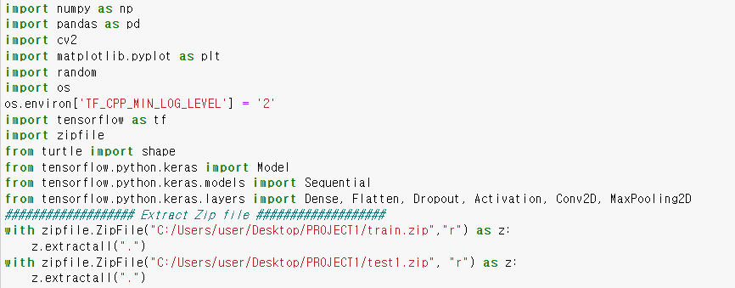
(1) Package and zipfile

Slide 9
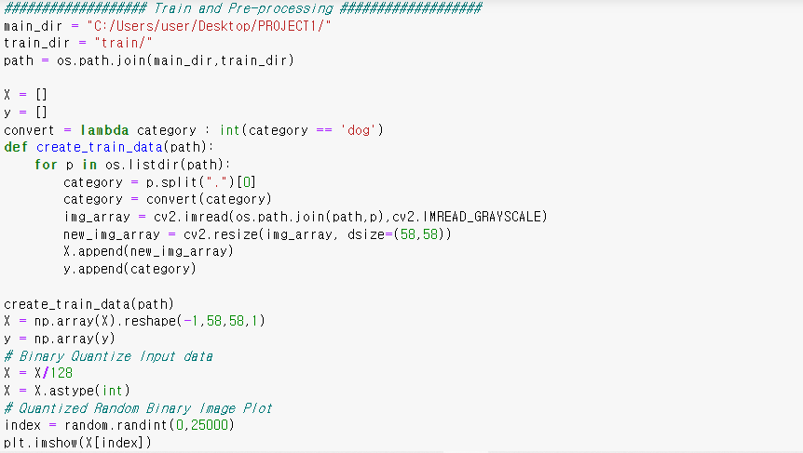
(2) Train and Pre-processing

Slide 10
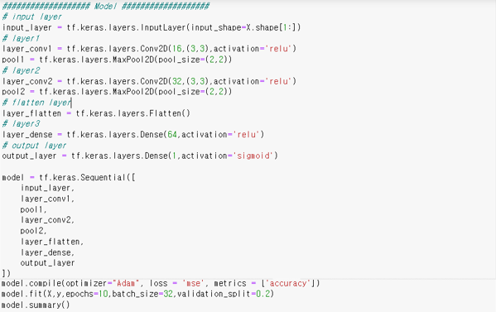
(3) Model and Training

Slide 11
(3) Model and Training
Performance greatly depends on the number of neuron in 1st FC layer
For training, we set batch size 32 to prevent over-fitting

Slide 12
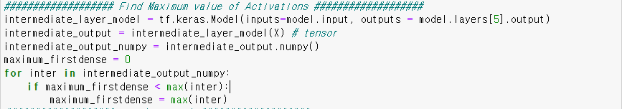
(4) Maximum value of activation
We find a maximum value in Dense layer
- Because dense layer does 5408 weight summation in one neuron
- The maximum value is Around 25

Slide 13
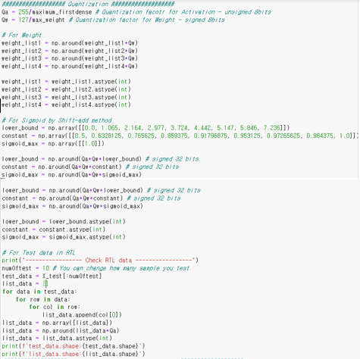
(5) Quantization

Slide 14
(5) Quantization
Find maximum value of weight, activation and proceed PTQ
Get lower boundary and constant of shift-add Sigmoid
For Verilog test data, we quantized unsigned 8 bits and save <name>.hex file.
This model don’t use bias.

Slide 15
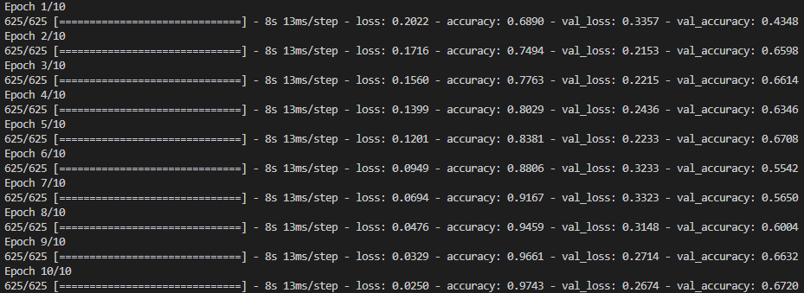
Output (1)
97.46% accuracy after 10 Epoch (maximum : 98.7%)

Slide 16
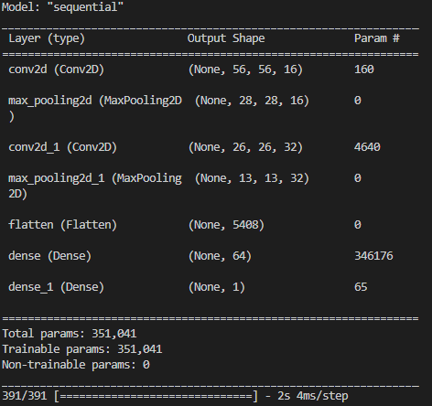
Output (2)
less number of total parameter : 351041 params

Slide 17
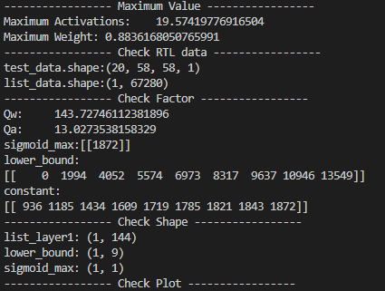
Output (3)
Maximum activation value : 19.574

Slide 18
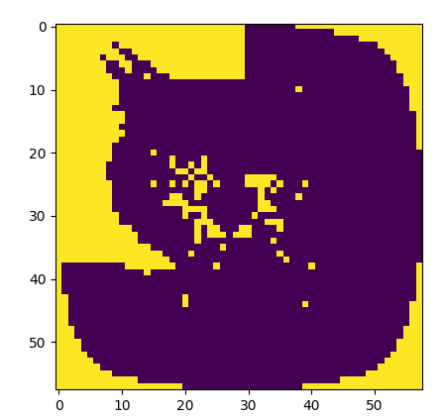
Output (4)

Slide 19
2. Verilog

Slide 20
Design Goals
Performance(latency) vs Area
- We choose area because this project doesn’t use real-time data.
Low Area model
- 1 PE (unit module)
- RAM for saving each layer’s outputs
- ROM for saving test data and each layer’s weights
- controller
Performance(latency) vs Area
- We choose area because this project doesn’t use real-time data.
Low Area model
- 1 PE (unit module)
- RAM for saving each layer’s outputs
- ROM for saving test data and each layer’s weights
- controller

Slide 21
- Module Analysis

Slide 22
(1) PE(Processing Element)
Sigmoid reset
Activation sel
Signed [7:0] data
Signed [7:0] weight
Sigmoid
Acc clear
Accumulator
ReLu
Output sel
Qw
[7:0] output

Slide 23
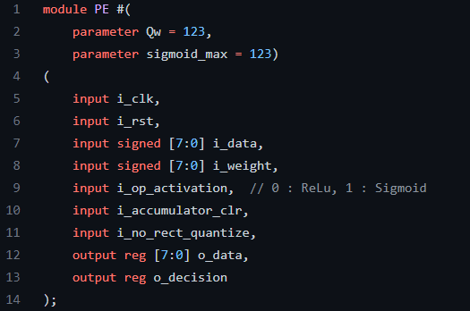
(1) PE(Processing Element)

Slide 24
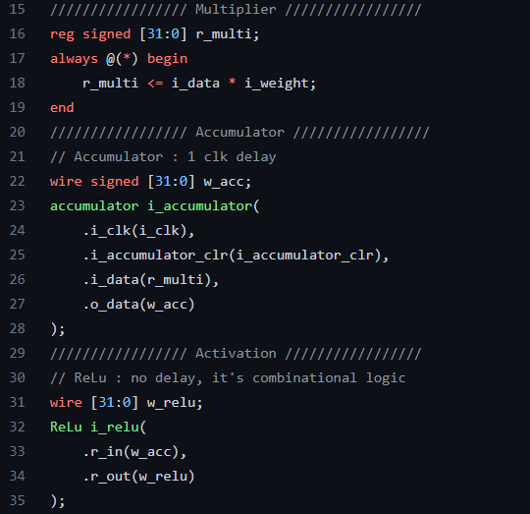
(1) PE(Processing Element)
In class, Relu designed sequential logic.
But we change combinational logic to decrease delay

Slide 25
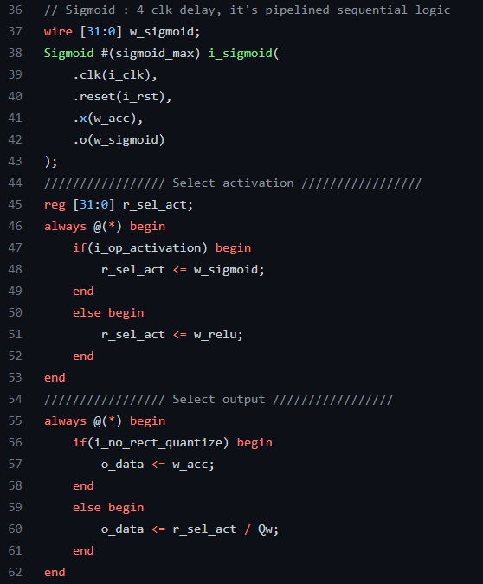
(1) PE(Processing Element)
Sigmoid activation is equal to pipelined shift-add module designed in class
Output is 8bits unsigned integer. (divided by Qw)

Slide 26

(1) PE(Processing Element)

Slide 27
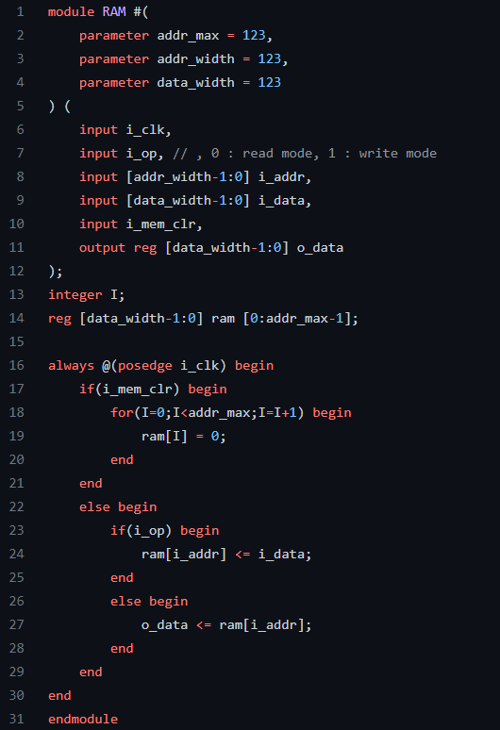
(2) RAM

Slide 28
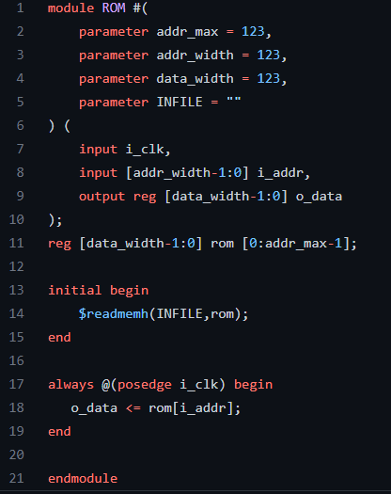
(3) R0M

Slide 29
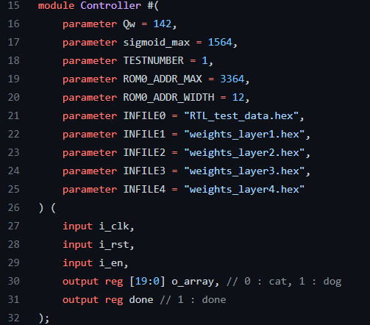
(4) Controller

Slide 30
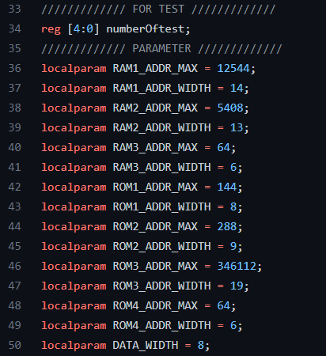
(4) Controller

Slide 31
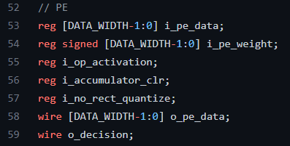
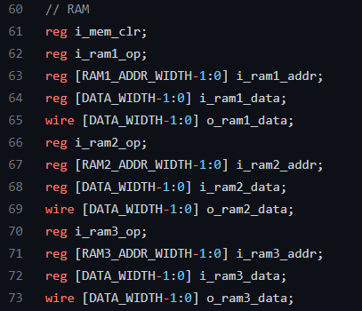
(4) Controller

Slide 32
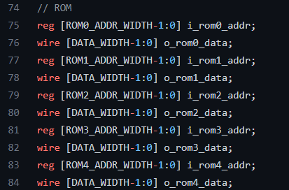
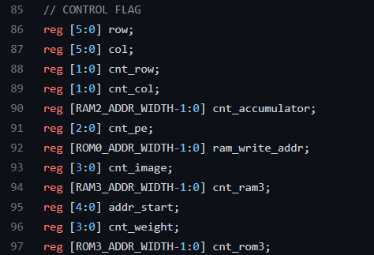
(4) Controller

Slide 33
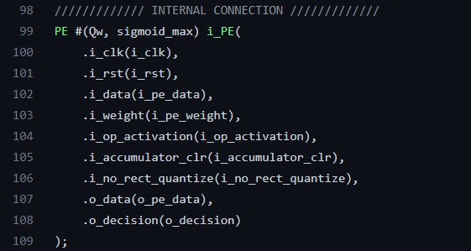
(4) Controller

Slide 34
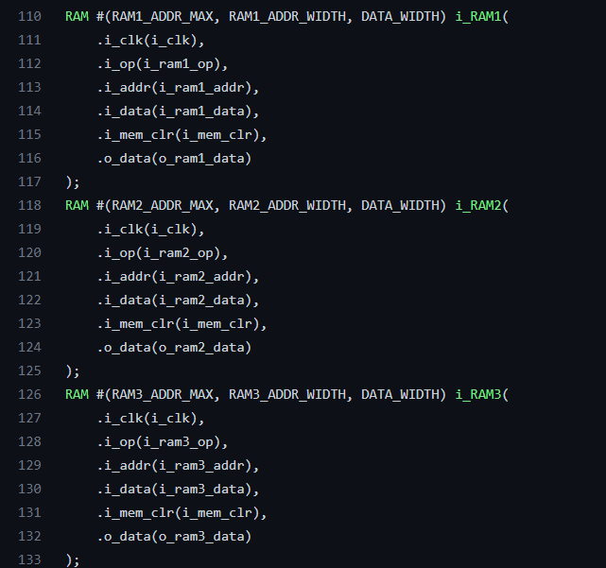
(4) Controller

Slide 35
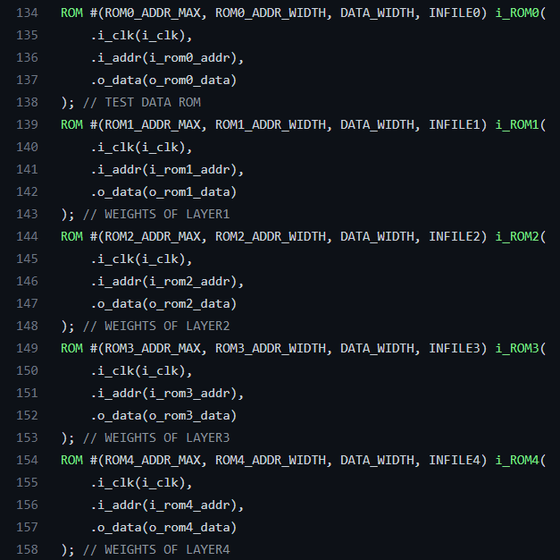
(4) Controller

Slide 36
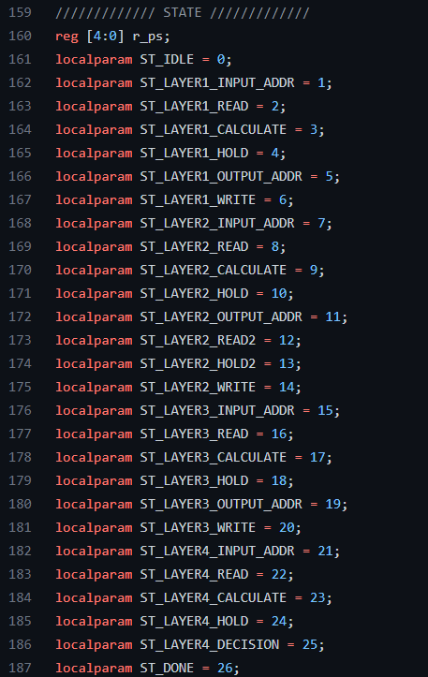
(4) Controller

Slide 37
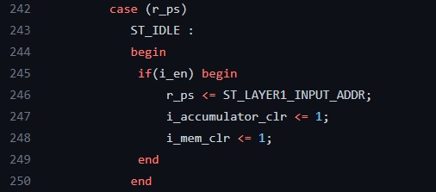
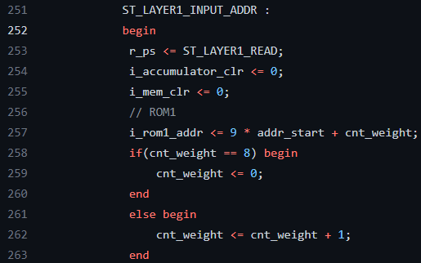
(4) Controller

Slide 38
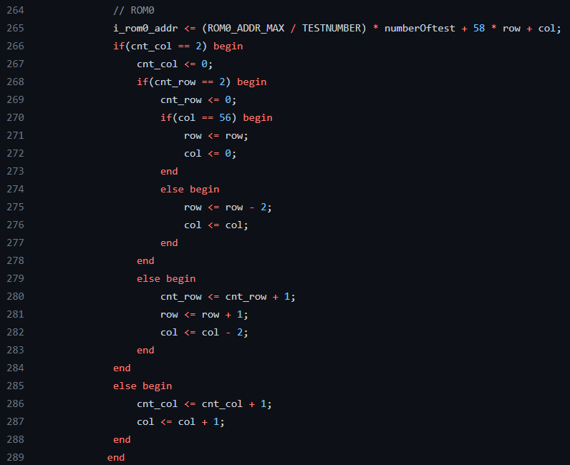
(4) Controller

Slide 39
(4) Controller
Assume. 2D convolution 3x3 kernel, 5x5 input
(1,1) will be calculated first

Slide 40
(4) Controller
Step 1. Col+1
Step 2. Col+1
The next pixel will be (1,2)
The next pixel will be (1,3)

Slide 41
(4) Controller
Step 3. Col-2, Row+1
Step4. Col+1
Step5. Col+1
Step6. Col-2, Row+1
pixel : (1,2)
-> These steps are equal to first 3steps

Slide 42
(4) Controller
Step7. Col+1
Step8. Col+1
-> These are same, too.
Step9. Row-2
2D Convolution stride 2
=2D Convolution stride 1 + maxpooling stride 2

Slide 43
(4) Controller
After applying same 8 steps, pixel will be like this
If Col arrives the last column, reset the smallest value.

Slide 44
(4) Controller
The output will be like this

Slide 45
(4) Controller
Col and Row are counter.
- The moved distance decides next move
- control by index counter col_cnt, row_cnt
If cnt_col==2, reset cnt_col,
cnt_row==2, reset cnt_row.

Slide 46
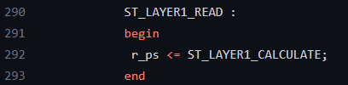
(4) Controller

Slide 47
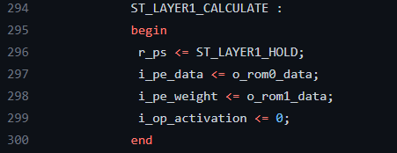
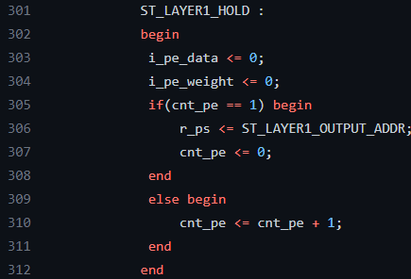
(4) Controller

Slide 48
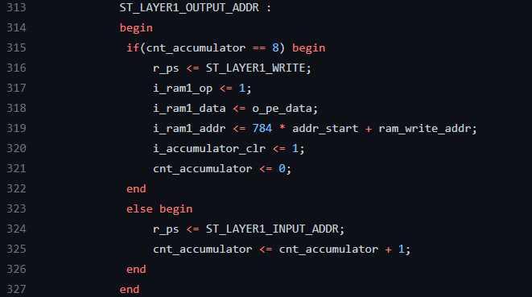
(4) Controller

Slide 49
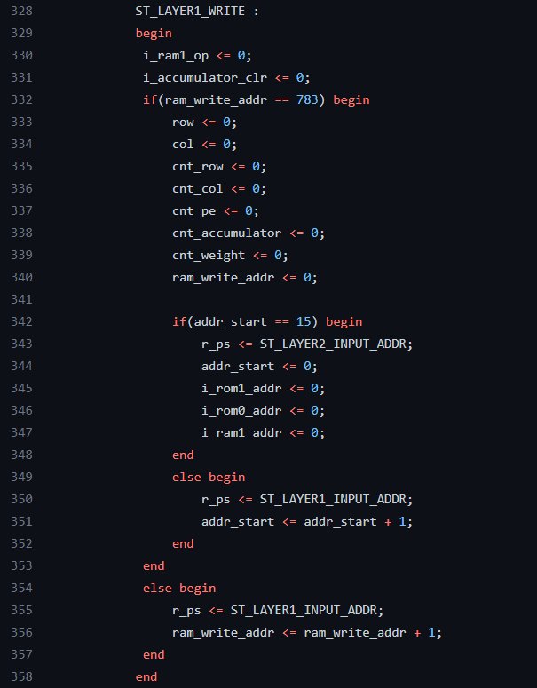
(4) Controller

Slide 50
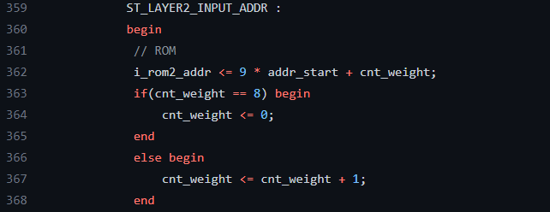
(4) Controller

Slide 51
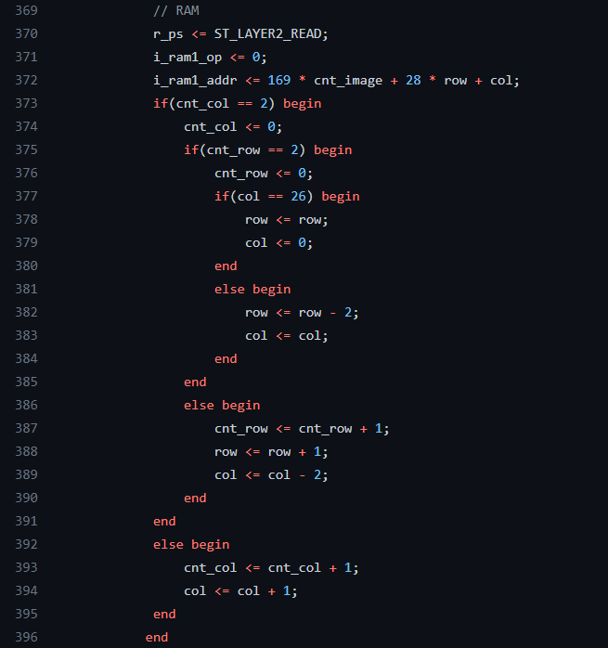
(4) Controller

Slide 52
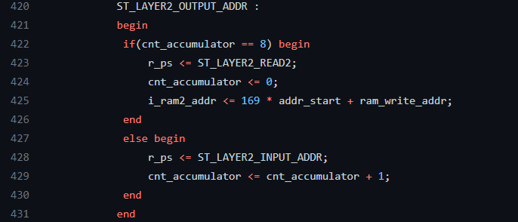
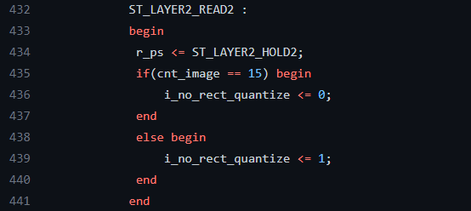
(4) Controller

Slide 53
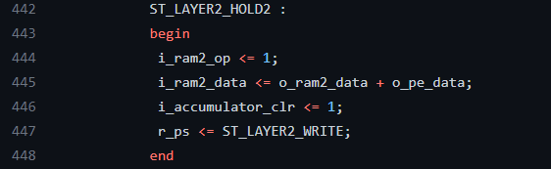
(4) Controller

Slide 54
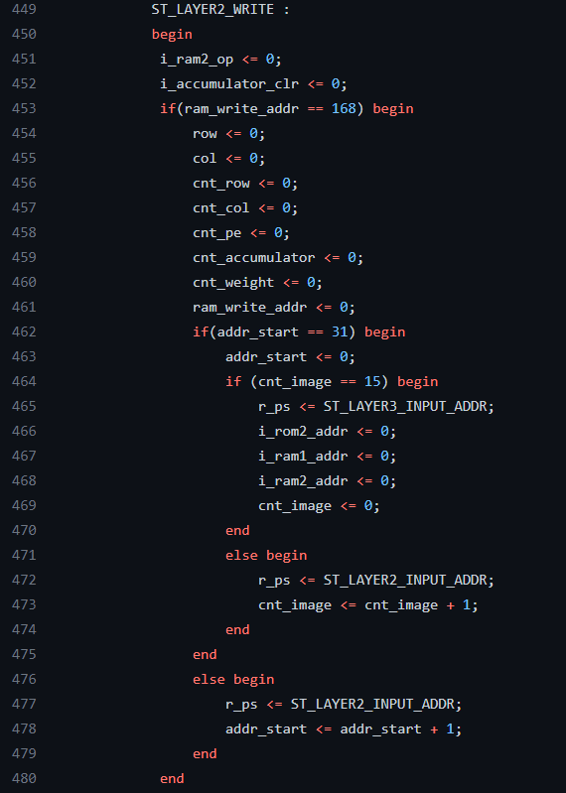
(4) Controller

Slide 55
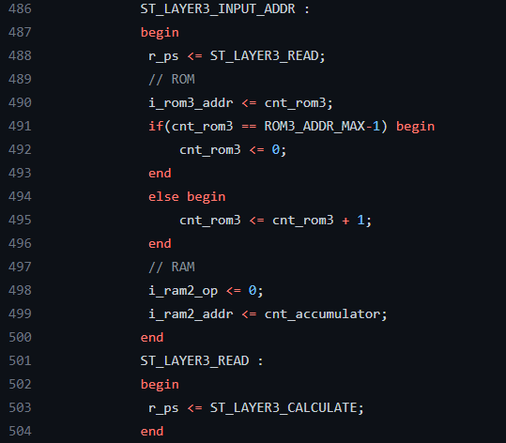
(4) Controller

Slide 56
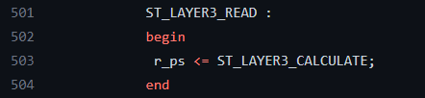
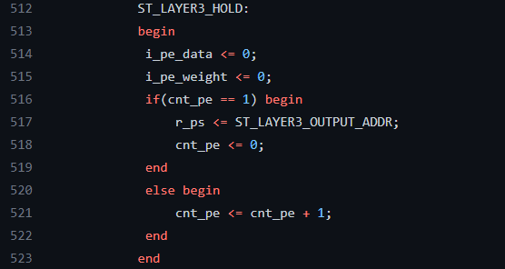
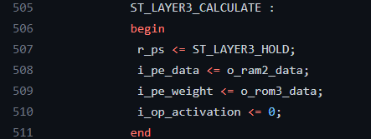
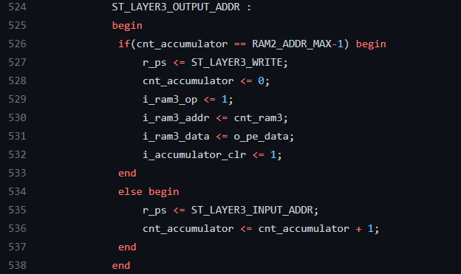
(4) Controller

Slide 57
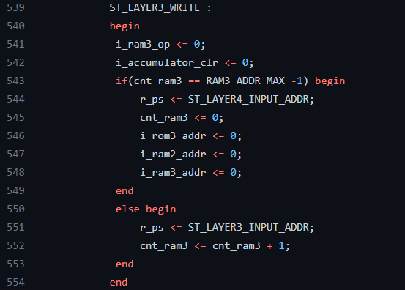
(4) Controller

Slide 58
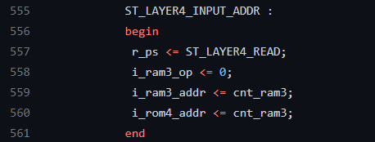
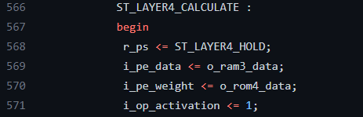

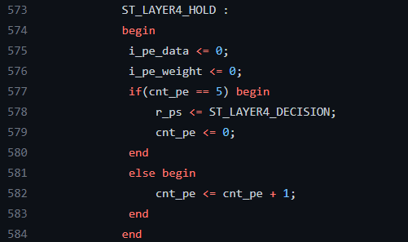
(4) Controller

Slide 59
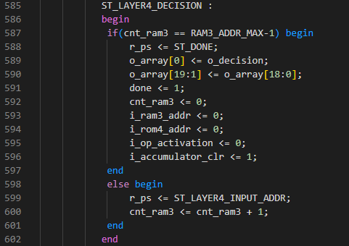
(4) Controller

Slide 60
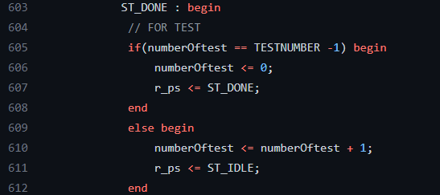
(4) Controller

Slide 61
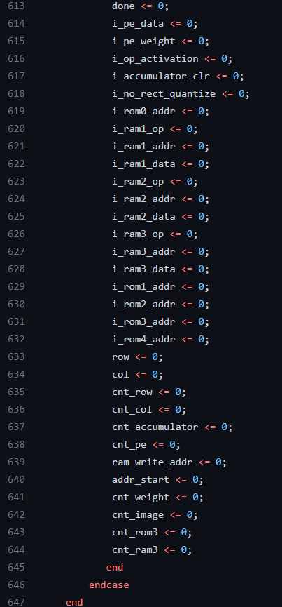
(4) Controller

Slide 62
- Result / Analysis

Slide 63


The number of clocks used for CNN
$Latency=7699392 clks$

Slide 64

Area
Controller and PE area 24330.
(exclude RAM and ROM)

Slide 65

Area
Chip size is 42141.
But this project doesn’t need to consider packaging,
So, the size is 23874.

Slide 66

Result
# Samples: 20, Python model accuracy 94.46% (Worst case)
Label: 10011001100000011000
Python: 10011101001000111000 Accuracy: 80%
Verilog: 10011111110111110110 Accuracy: 50%

Slide 67

Result
$$e=area∗\frac{latency}{accuracy}$$
Area = 23874, latency = 7699392, accuracy = 50
e=3.68e10

Slide 68
Analysis
Why we get too much loss?(20times test, avg30%)
- Quantization loss because of high variance of each layer’s maximum activation value
- Shift-add has high error rate near zero
Solution
- Lower variance of each layer’s maximum activation value
- change Output layer’s activation
- 1st FC layer should perform lower summation
->To meet this requirements, layer should be deeper, and
deep layer model occurs covariance shift
->Require more module like Batch Normalization

